Slide 1
Wisconsin Breast Cancer CELL Diagnostic Data
a case in Linear Discriminant Analysis | Artificial Intelligence via Machine Learning

Slide 2
Team 2
MSDS 6372 - 402 Applied Statistics: Inference and Modeling, Project II
Ranga Nagarajan
Rob Rivens
Adam Tschannen

Slide 3
Breast Cancer Wisconsin (Diagnostic) Data Set
When cells in the breast begin to grow out of control, this is typically a signal that breast cancer is beginning to form. The abnormal cells usually form a tumor that can often be detected via x-ray or felt as a lump. The tumor is malignant (or cancerous) if the cells invade surrounding tissues or spread to other areas of the body. In fact, cells in nearly any part of the body can become cancerous.
Research indicates that most breast lumps are benign and not cancer (or malignant). Non-cancerous breast cells (called tumors) are abnormal growths, but they do not spread outside of the breast and they are not life threatening. Some benign breast lumps can increase a woman's risk of getting breast cancer at a later date. As such, any breast lump or change needs to be checked by a health care professional to determine if it is benign or malignant (cancer) and if it might affect a person’s future cancer risk¹.
Since malignant cells are typically malformed, research has shown that measuring various parts of the cell can aid in identifying malignant vs benign cells (Figure 1).
The cancer cell dataset obtained from Kaggle³ features variables computed from a digitized image of a fine needle aspirate (FNA) of a breast mass, which describe characteristics of the cell nuclei present in the image.
Attribute Information:
1) ID number
2) Diagnosis (M = malignant, B = benign)
3-32) Ten features computed for each cell nucleus:
a) radius (mean of distances from center to points on the perimeter)
b) texture (standard deviation of gray-scale values)
c) perimeter
d) area
e) smoothness (local variation in radius lengths)
f) compactness (perimeter^2 / area - 1.0)
g) concavity (severity of concave portions of the contour)
h) concave points (number of concave portions of the contour)
i) symmetry
j) fractal dimension ("coastline approximation" - 1)
Note:
The mean, standard error and largest (mean of the three largest values – called “Worst”) of these cell nucleus characteristics were computed for each image, resulting in 30 total features.
Figure 1

Slide 4

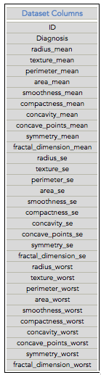
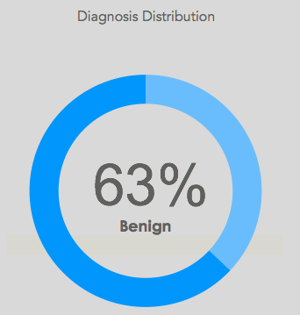
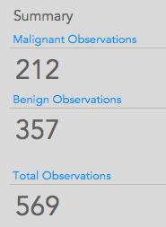
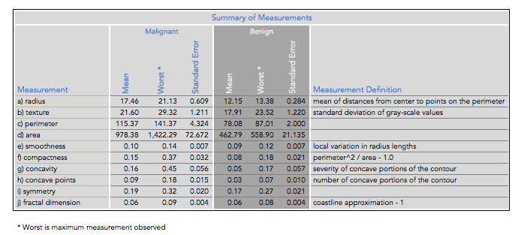
Quick look: datASET attributes²
Figures 2 - 5

Slide 5
State of the data | MODEL SELECTION
There were no missing attribute values. We had to clean-up some of the variable names, as some of them had spaces, which caused initial SAS import to account for more variables than were actually in the data. Adding an underscore to connect variables titles resolved this issue. We also had to add a binary indicator for “Malignant” vs “Benign”, as the Principal Component Analysis requires numerical values in order to function properly.
Method Selectionª
We decided to use Linear Discriminant Analysis (LDA) to model the data. LDA is used to determine which continuous variables discriminate between two naturally occurring groups. In this case, the cell characteristics are the variables and “Benign” vs “Malignant” are the groups. The fact that we only had two categorical states -- Benign and Malignant – made our dataset perfect for using LDA. First, we needed to ensure our data met the requirements for LDA. Categorically:
Sample size: Unequal sample sizes acceptable, therefore we will proceed, despite our 63%/37% benign vs malignant samples.
Normal distribution: due to the number of observations, under the Central Limit Theorem, it is assumed that the data represent a sample from a multivariate normal distribution.
Homogeneity of variances: LDA is very sensitive to heterogeneity of variance-covariance matrices. Homoscedasticity is evaluated through scatterplots and corrected by transformation of variables. We will evaluate the Simple (summary) Statistics and run a log transformation, if necessary.
Non-multicollinearity: If one of the independent variables is very highly correlated with another, or one is a function of other independents, then the tolerance value for that variable will approach 0 and the matrix will not have a unique discriminant solution. Since Principles Component Analysis alleviates collinearity, we will proceed with a PCA, then LDA.
The “training data set” features 30 variables, with the following Class distribution: 357 benign and 212 malignant cells. We ran a FULL PRINCIPLE COMPONENTS ANALYSIS, which we intended to use to reduce the number of variables from 30 to a more manageable number, and also to explore the relationship between the variables.

Slide 6
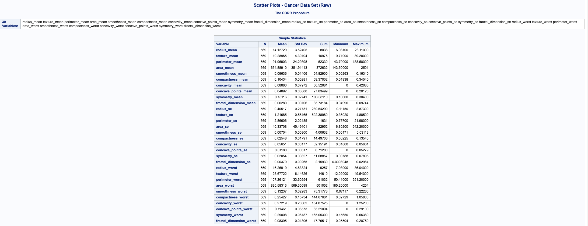
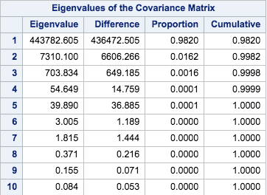
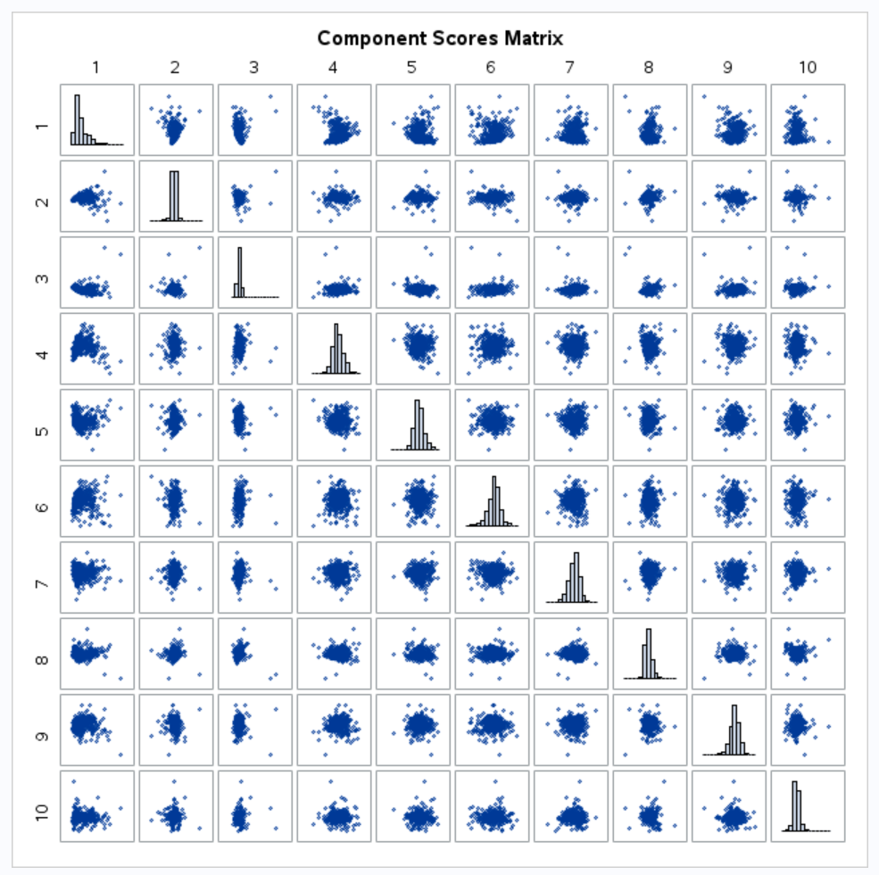
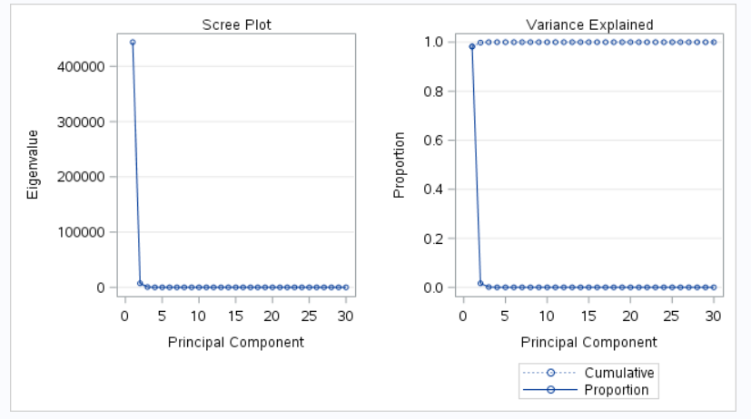
principle component analysis
Upon examination of the Simple Statistics matrix, we saw that there were a few Means which were drastically different in scale from the others. Since LDA is sensitive to scale, we decided we needed to further explore the possibility of transforming the data (Figure 6).
Reviewing the Eigenvalues of the Covariance Matrix, we discovered that the large-scaled values were causing the cumulative Principle Components composition to reflect 98% of the proportion of differences to be reflected in the first Component (Figure 7). Examination of the Scree Plot and Variance Explained graph confirmed this effect (Figure 8). The Component Scores Matrix (Figure 9) was difficult to analyze due to the number of components, but we felt confident that given the aforementioned effect of the scale issue, we needed to perform a log transformation on the data.
Figure 6
Figure 7
Figure 8
Figure 9

Slide 7
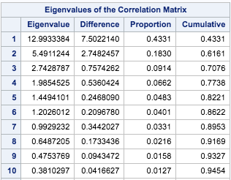
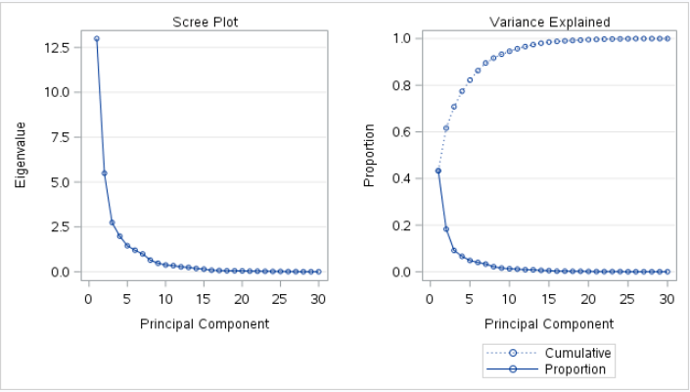
principle component analysis
We then realized that we needed to look at the Eigenvalues of the Correlation Matrix, as well. Due to different scaling of variables, we knew that mathematically, the Covariance Matrix would be heavily influenced by variables with large variances.
Reviewing the Eigenvalues of the Correlation Matrix, we discovered that the large-scaled values didn’t have much of an impact, as we’d need to consider nine (9) Principle Components to reflect 93% of the cumulative differences. Examination of the Scree Plot and Variance Explained graph confirmed this effect (Figures 10 and 11).
We decided to continue with our Log Transformation, to see of this would help reduce the number of Principle Components…
Figure 10
Figure 11

Slide 8
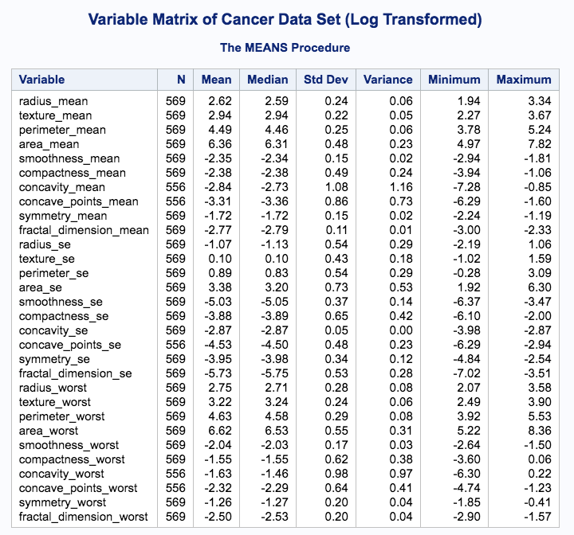
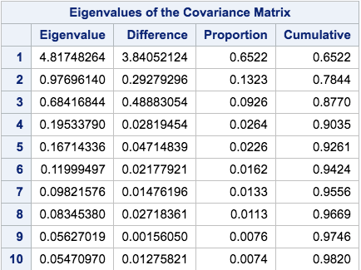
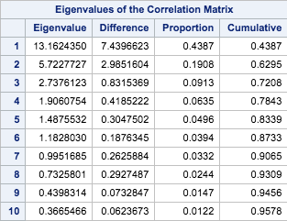
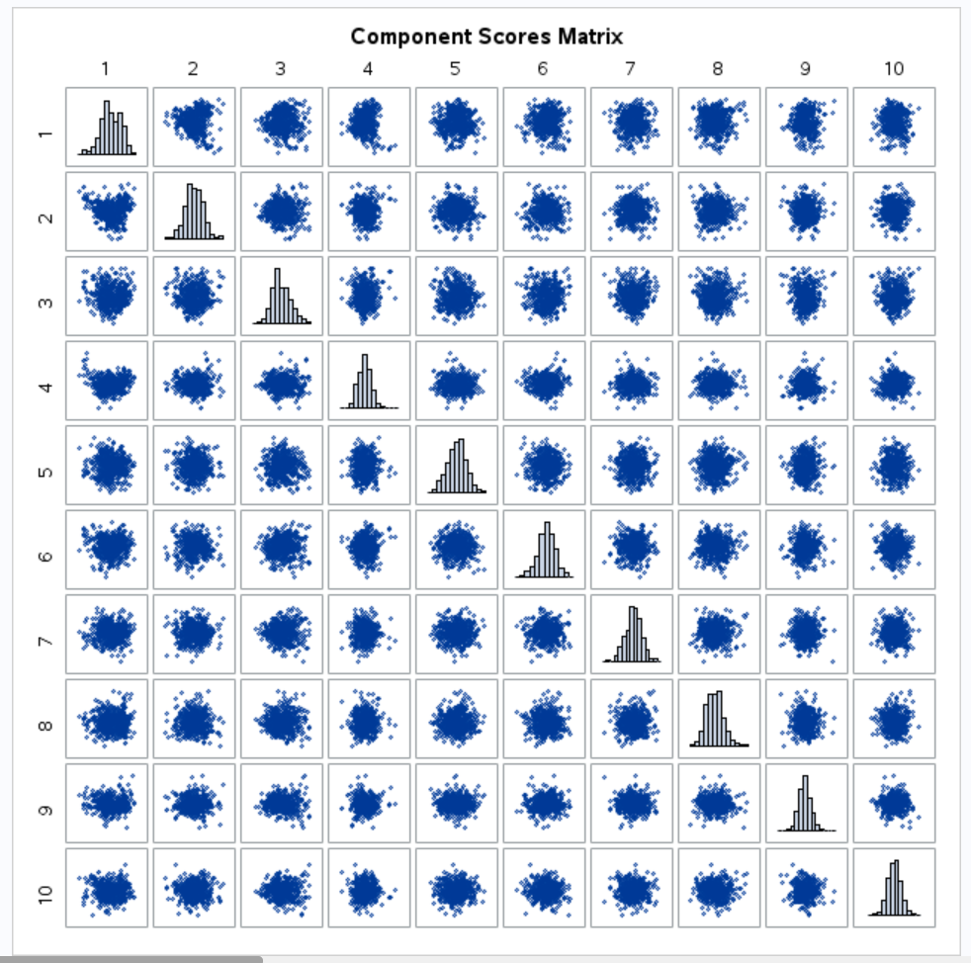
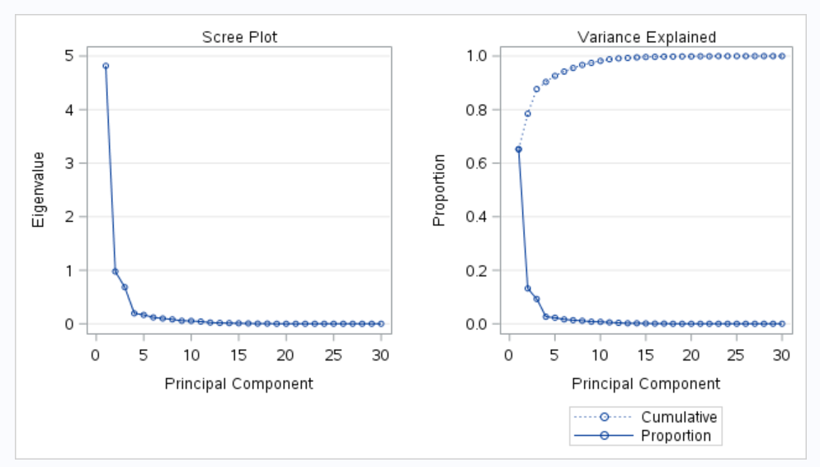
principle component analysis_v2.0
Upon examination of the log transformed Simple Statistics matrix, we saw that the Means were now roughly on the same scale for all variables (Figure 12). This will now satisfy the scale guideline for arriving at a more reasonable output from our PCA.
Reviewing the Eigenvalues of the log transformed Correlation Matrix, we discovered that the cumulative Principle Components composition to reflect 93% of the proportion of differences requires at least eight (8) Components – a slight improvement vs the previous results (Figure 13). Examination of the Scree Plot and Variance Explained graph confirmed this effect (Figure 14). Although the Component Scores Matrix (Figure 15) is still a bit of an eye-chart due to the number of components, we can confirm the normality of histograms and lack of linearity in the scatter plots due to the Central Limit Theorem and the effect of running the PCA (uncorrelated data).
Figure 12
Figure 13
elbow
Figure 14
Figure 15

Slide 9
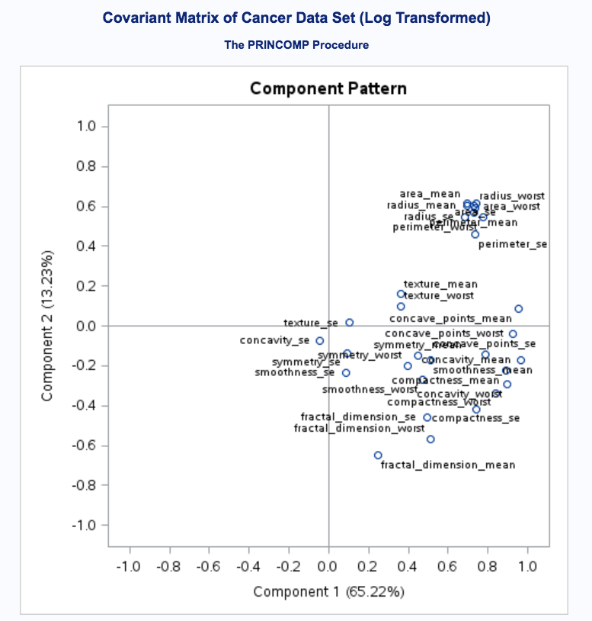
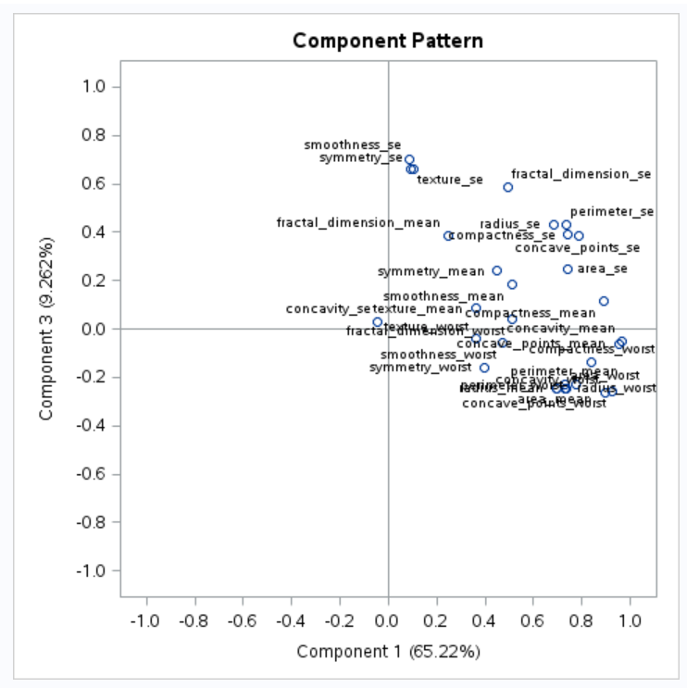
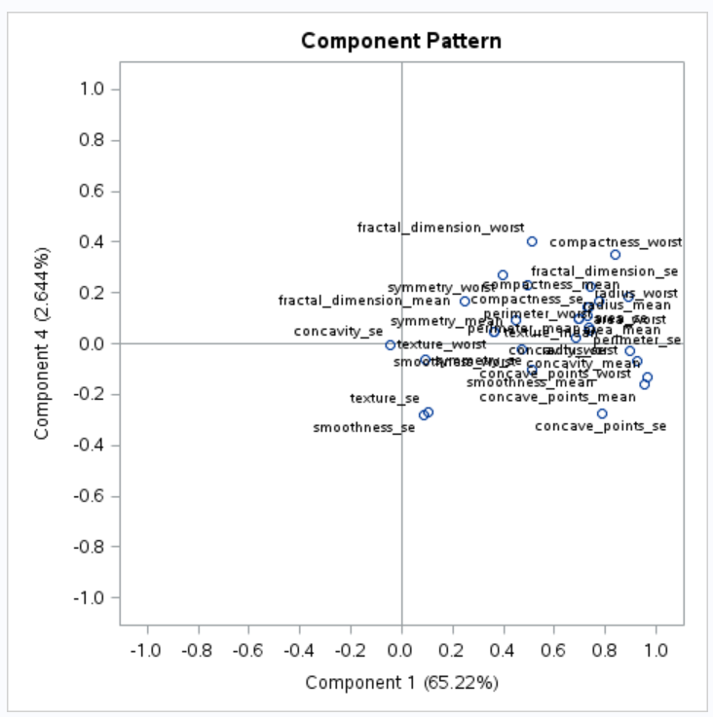
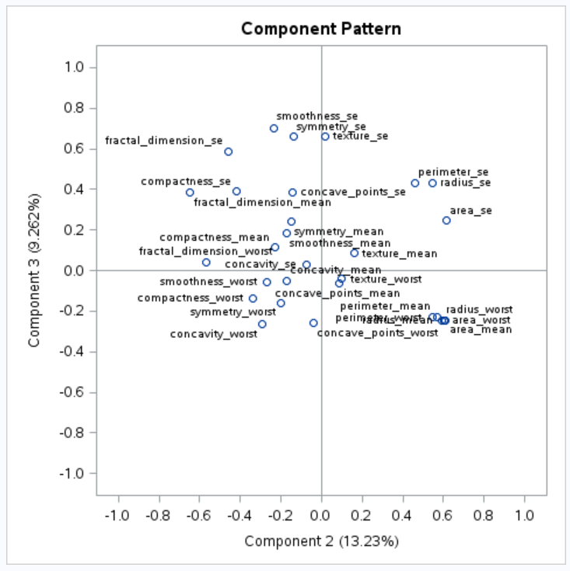
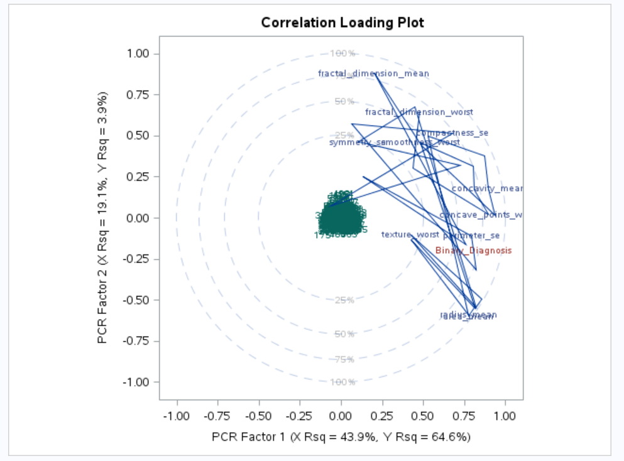
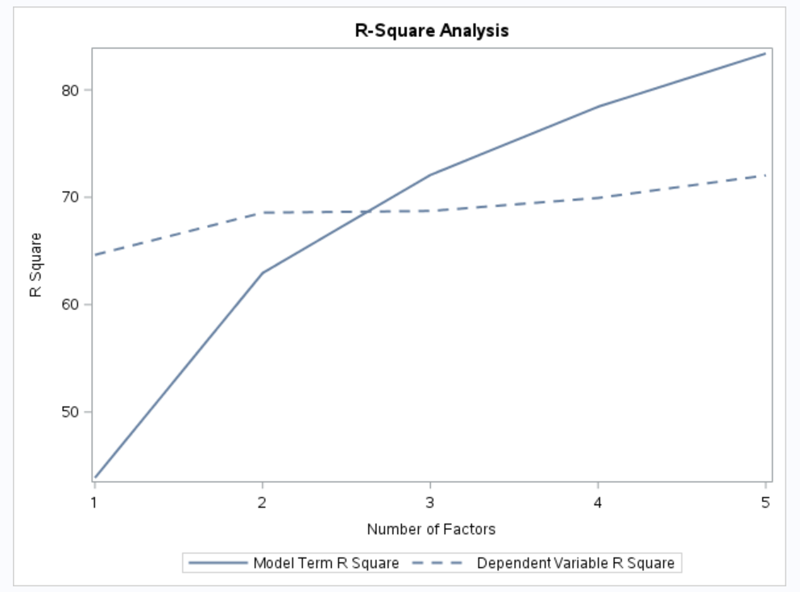
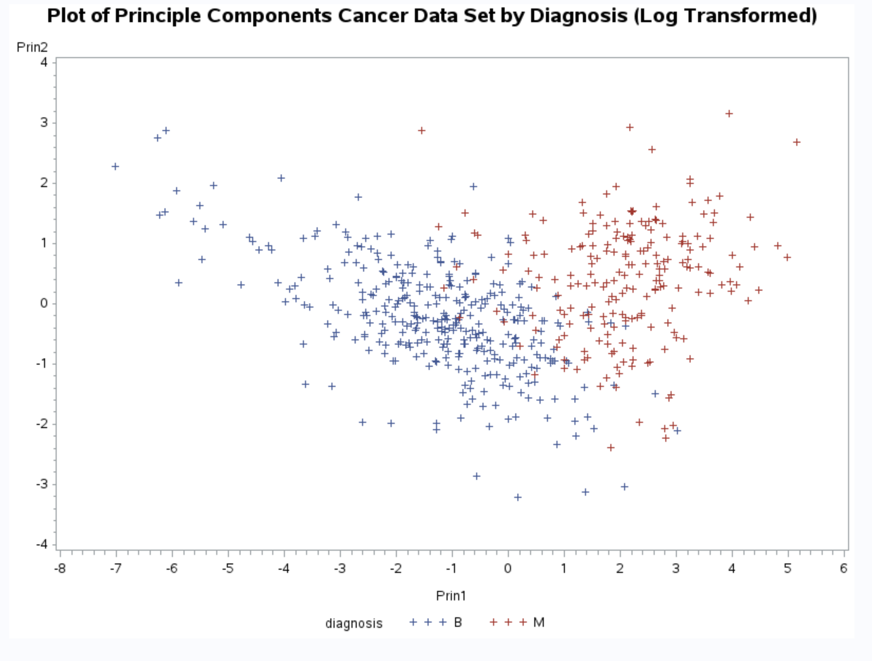
principle component analysis_v2.0
Figure 16
The Eigenvectors used to determine which components we used to create our new Explanatory Variables are depict the loading graphically (Figures 16 - 18).
Figure 19 shows the delineation between Benign (blue) and Malignant (red) cancer cells in the dataset. There is a clear distinction between the groups, with only a minimal overlap.
Figure 17
Figure 18
Figure 19

Slide 10
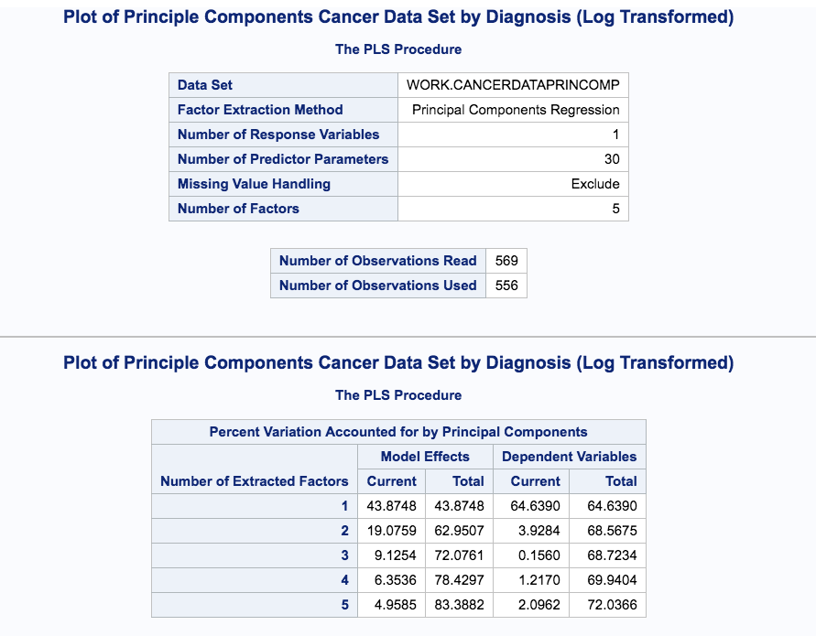
But wait…
Figure 20
We noticed that not all the data was being used (Figure 20). Upon further discussion, we identified that using a log function to transform the data meant any negative or zero values would result in missing data. As a result, we used the following selected adjustments to standardize the data (Figure 21):
radius_mean = (radius_mean/10)
texture_mean = (texture_mean/10)
perimeter_mean = (perimeter_mean/100)
area_mean = (area_mean/1000)
texture_se = (texture_se/10)
perimeter_se = (perimeter_se/10)
area_se = (area_se/100)
radius_worst = (radius_worst/100)
texture_worst = (texture_worst/100)
perimeter_worst = (perimeter_worst/100)
area_worst = (area_worst/1000)
Figure 21

Slide 11
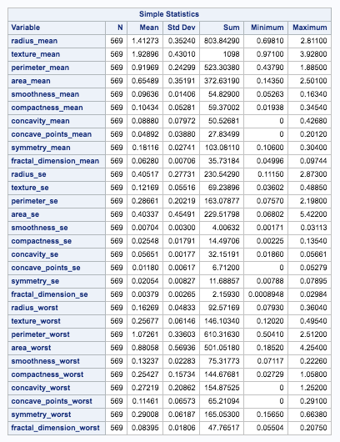
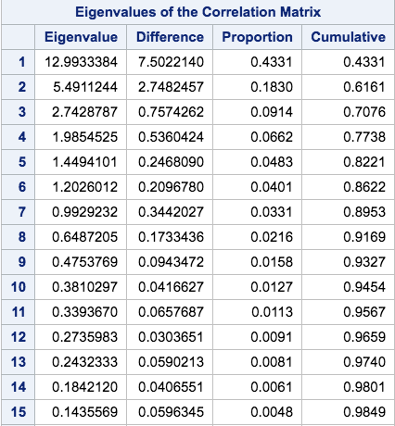
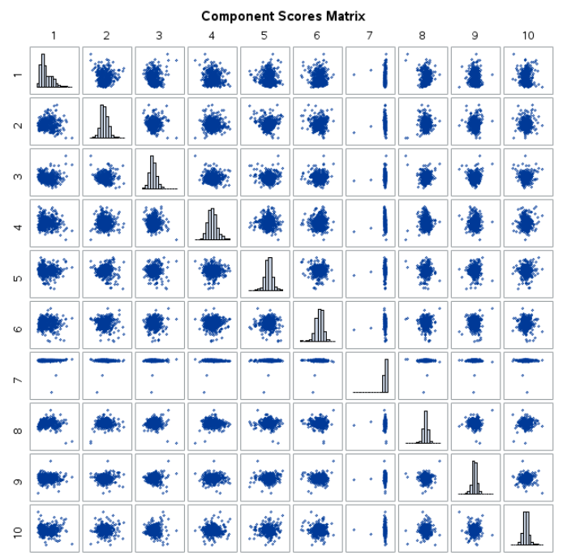
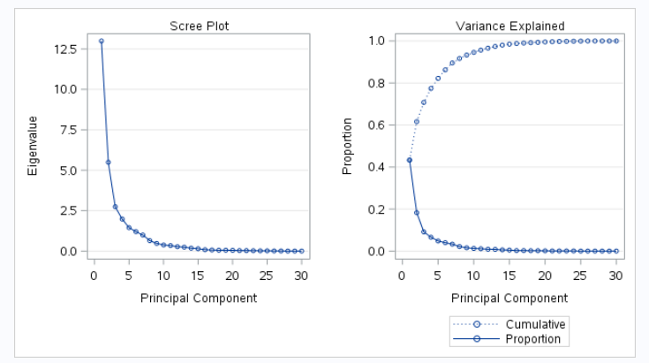
principle component analysis_v3.0
Upon examination of the standardized Simple Statistics matrix, we saw that the Means were now roughly on the same scale for all variables (Figure 22). This will now satisfy the scale guideline for arriving at a more reasonable output from our PCA.
Reviewing the Eigenvalues of the log transformed Covariance Matrix, we discovered that the cumulative Principle Components composition to reflect 93% of the proportion of differences requires at least nine (9) Components (Figure 23). Examination of the Scree Plot and Variance Explained graph confirmed this effect (Figure 24). Although the Component Scores Matrix (Figure 25) is still a bit of an eye-chart due to the number of components, we can confirm the normality of histograms and lack of linearity in the scatter plots due to the Central Limit Theorem and the effect of running the PCA (uncorrelated data).
Figure 22
Figure 23
elbow
Figure 24
Figure 25

Slide 12
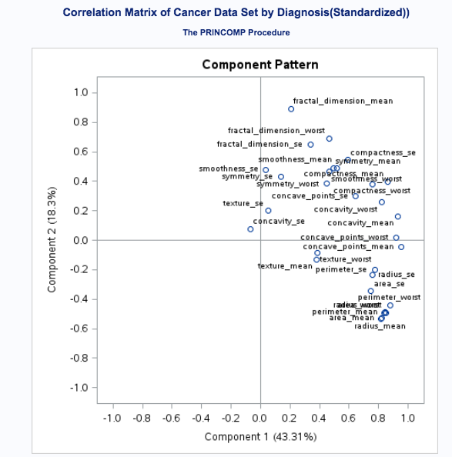
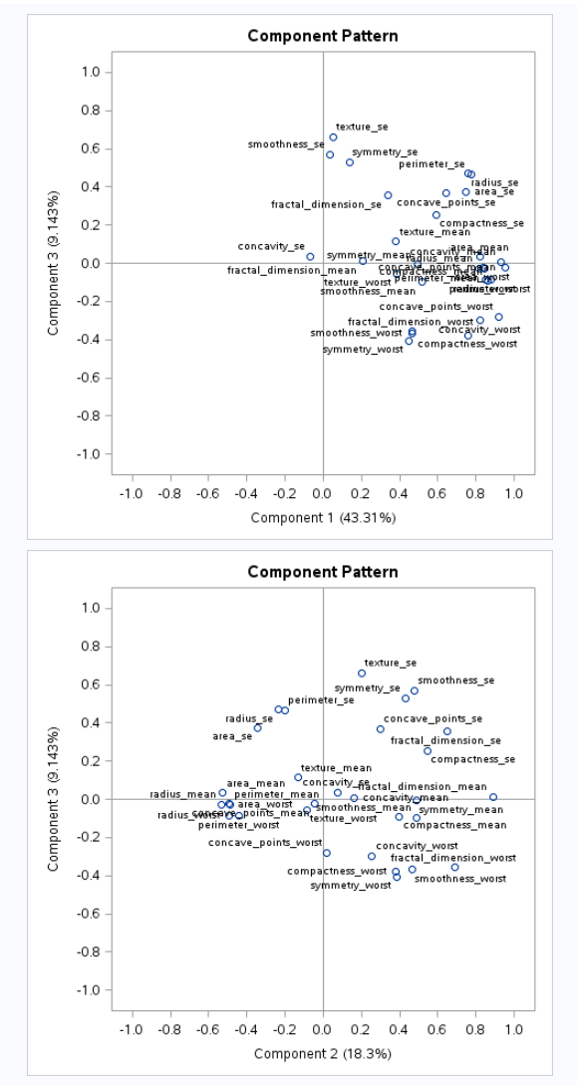
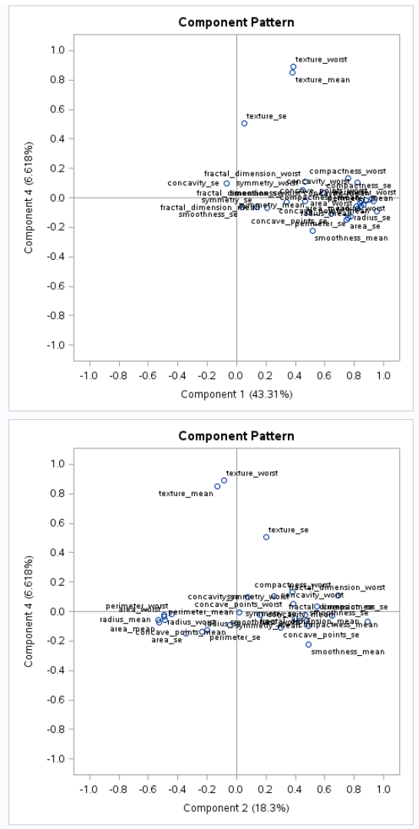
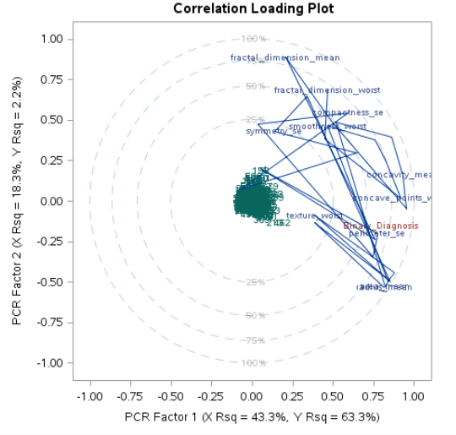
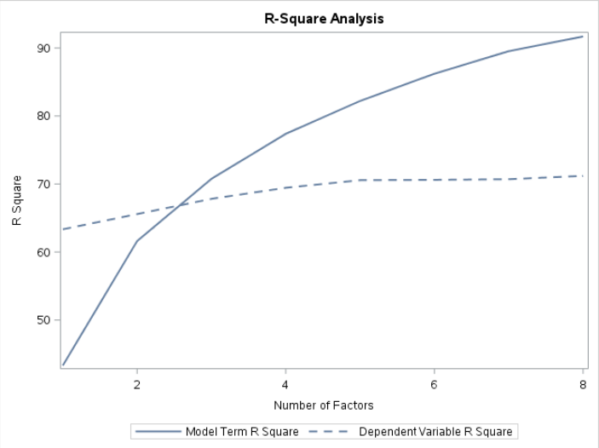
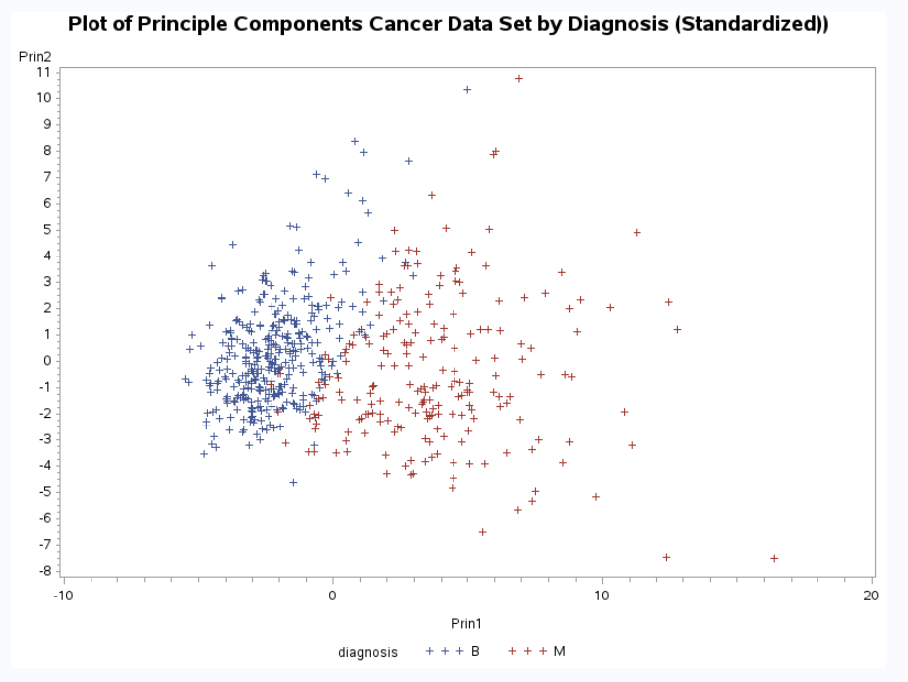
principle component analysis_v3.0
Figure 26
The Eigenvectors used to determine which components we used to create our new Explanatory Variables are depict the loading graphically (Figures 26 - 28).
More specifically, Figure 27 depicts the Loading of variables included in the PCA, in a radial format. Figure 28 confirms the % of Variance – about 90% – explained by the first eight (8) factors in the model. Figure 29 shows the delineation between Benign (blue) and Malignant (red) cancer cells in the dataset for Principle Components 1 & 2. There is a clear distinction between the groups, with only a minimal overlap.
Figure 27
Figure 28
Figure 29

Slide 13
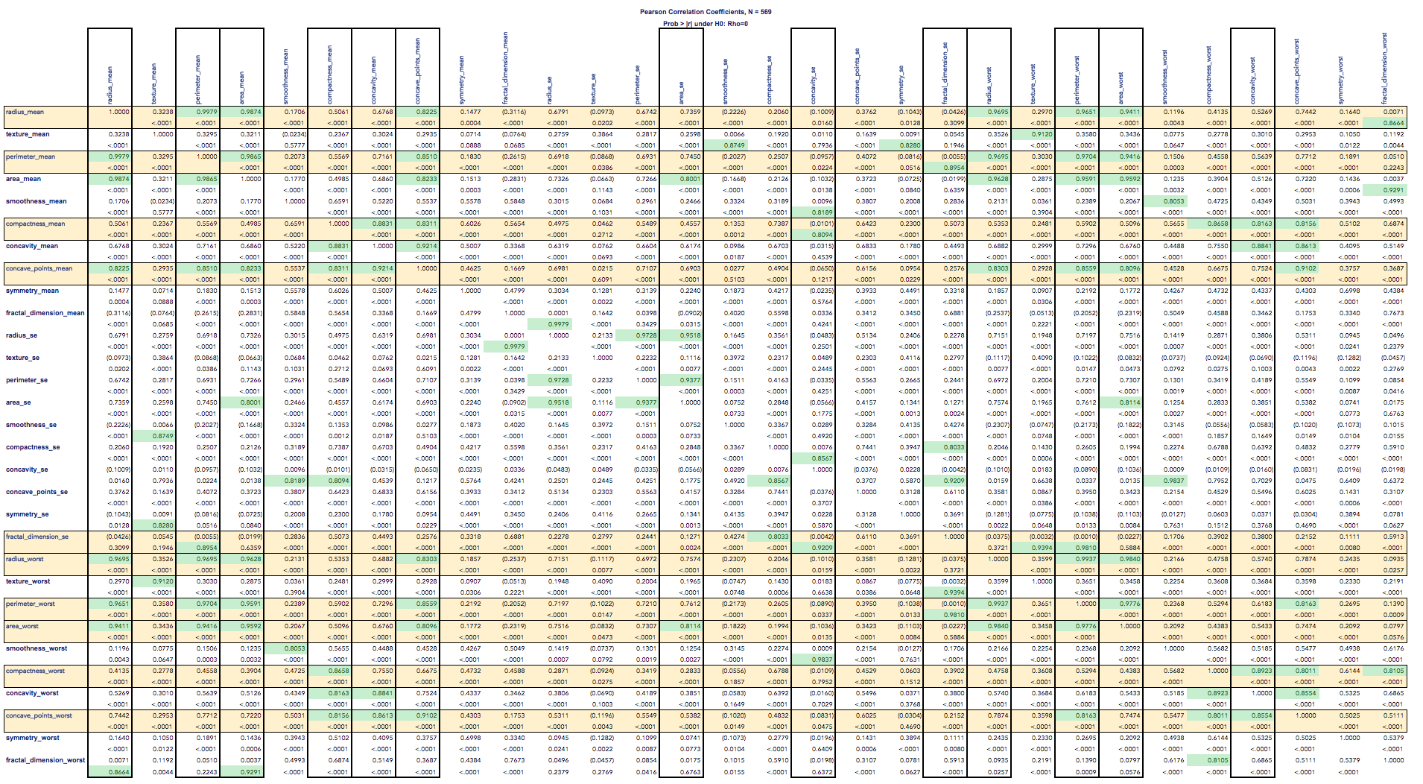
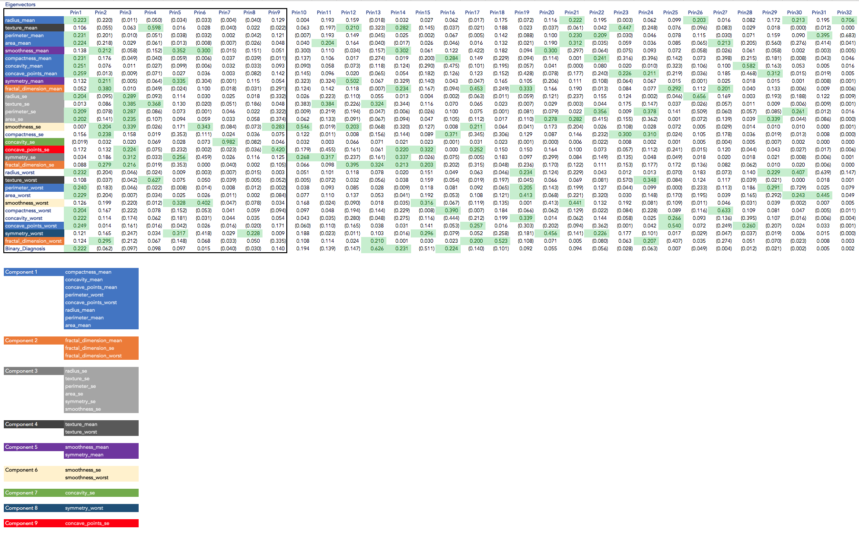
principle component analysis_v3.0
Figure 30
The Correlation Coefficients show significant relationships in certain variables (highlighted green in Figure 30). Since this table is intimidating, we rely on the cumulative coefficients identified in the Principle Components Analysis. Therefore, are satisfied with our visual and statistical analyses and will proceed in running the LDA with nine (9) principle components.
We decoded the Principle Components in the table, below (Figure 31):
Compactness
Dimensions (Area/Perimeter)
Concavity
Significant Cell Characteristics
Fractal Dimensions
Dimensions (Area/Perimeter/Radius)
Texture
Texture
Smoothness
Symmetry
Smoothness
Concavity
Symmetry
Figure 31
Concave Points

Slide 14

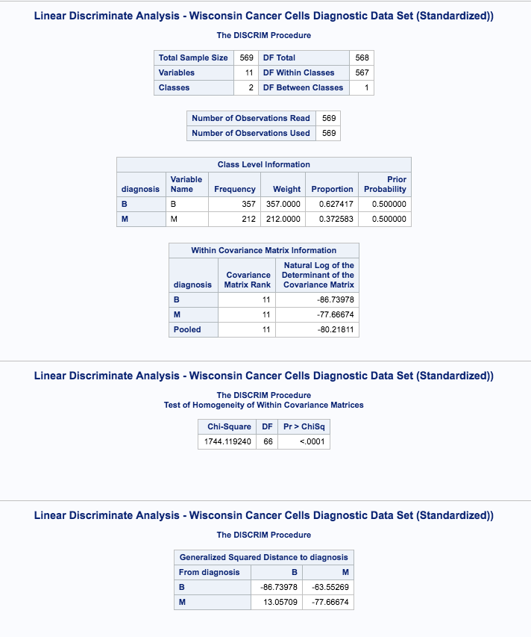
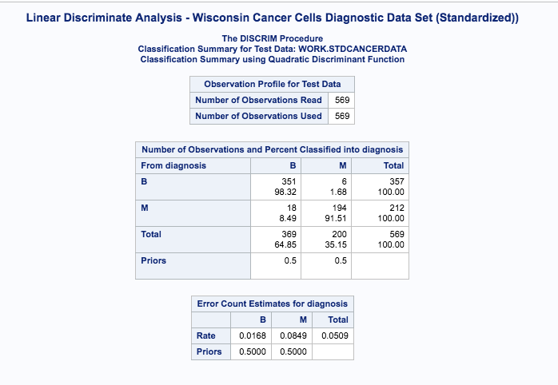
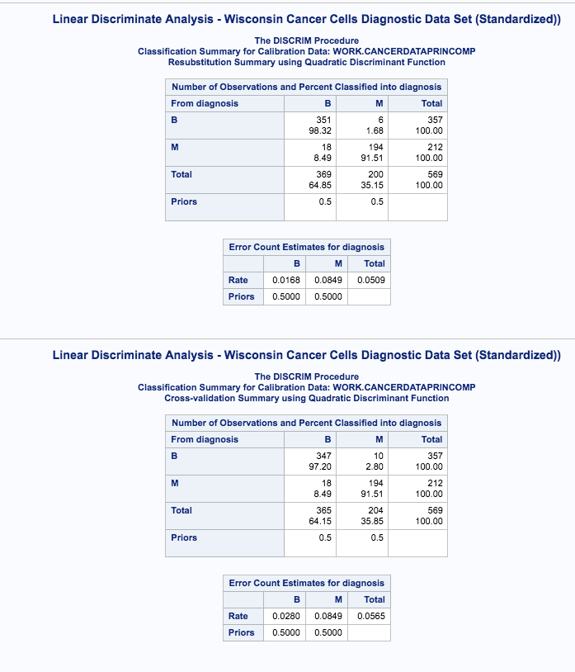
interpretation
In order to properly interpret our results, we review Bayes’ Theorem³:
“…the probability of an event, based on prior knowledge of conditions that might be related to the event.”
In our case, we expect our model to consider the probability of cells being classified as “Benign” or “Malignant”, given the test model and variables chosen in the PCA model. We assumed a 50/50 chance of classification (although we could have used our knowledge of the data being 63%/37% Benign vs Malignant).
We allowed SAS to determine whether to use a Linear Discriminate Analysis or a Quadratic Discriminate Analysis. Since the P-Value for the Test of Homogeneity was significant, the model selected a Quadratic Discriminate Analysis (Covariance Matrices are not same for Benign and Malignant -- Figure 32).
Our SAS output reveals a split of 64.85% Benign and 35.15% Malignant, given priors of 50/50 (Figure 33).
The Cross-Validation Summary shows the error-rates by Diagnosis; about 3% for Benign and 8.5% for Malignant diagnoses, respectively. The average error-rate for both diagnoses is about 5.7% (Figure 34).
In conclusion, based on Occam's Razor, our PCA model identified nine (9) principle components, which explained 93% of the cell characteristics needed to automatically determine the status of a Benign vs Malignant Cancer Cell. Our model – using 569 observations – made these predictions with a 5.7% error-rate.
Note to Professor: in the real world, in the case of a determination as serious as cancer, we discussed that we PERSONALLY would want our error rate to be as low as possible. To test this notion, we ran the PCA with all 15 components and only yielded a .7% improvement in the overall error rate. As a result. we feel good about our analysis from an academic and practical standpoint.
Figure 32
Figure 33
Figure 34

Slide 15
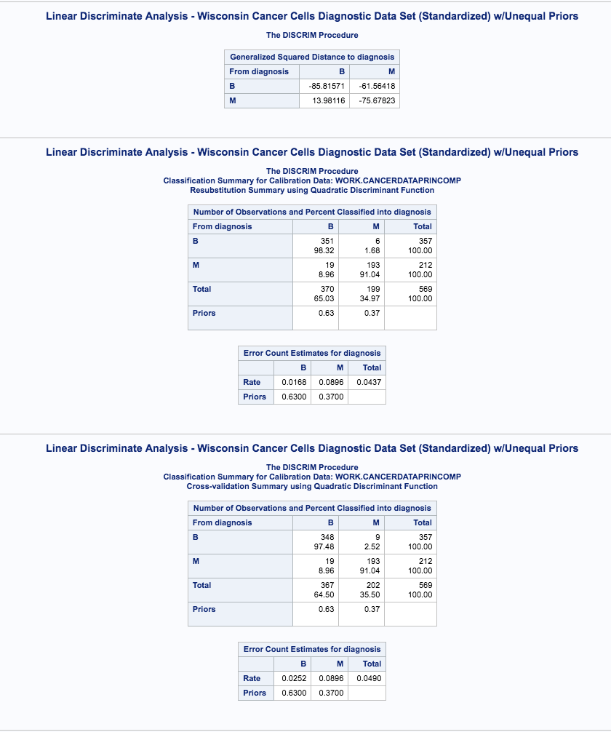
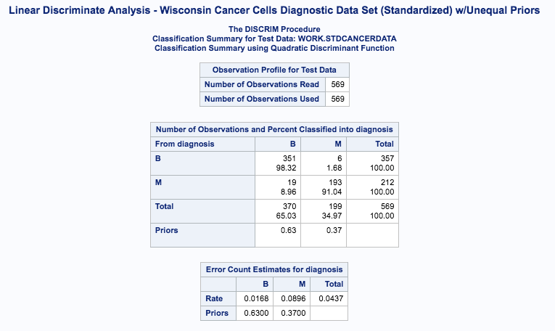
Alternate ending…
We wondered what would happen if we adjusted our Priors from the default of 50/50 to 63/37 -- the distribution of our Benign vs Malignant diagnoses obtained from the dataset. In doing so, we observed that our SAS output revealed a split of 62.7% Benign and 37.3% Malignant, given priors of 63/37 (Figure 35).
The Cross-Validation Summary shows the error-rates by Diagnosis; about 1.7% for Benign and 9% for Malignant diagnoses, respectively. The average error-rate for both diagnoses is about 4.4% (Figure 36).
In our “alternate ending”, we improved the error-rate by 1.3 percentage points. Essentially, adjusting the priors improved the Benign diagnosis error-rate and slightly worsened the Malignant diagnosis error-rate. This makes sense, as the model would default to Benign in the case of a close diagnosis. In practice, we would choose unequal priors in order to achieve a lower overall error-rate.
Figure 35
Figure 36
Figure 34

Slide 16
Appendix

Slide 17
Sas code
/*Read in Cancer Data*/data CancerData;
infile '/home/rrivens1/MSDS 6372 Applied Statistics Inference and Modeling/CancerData.csv' dlm=',' firstobs=2 missover;
input id diagnosis $ radius_mean texture_mean perimeter_mean area_mean smoothness_mean compactness_mean concavity_mean concave_points_mean symmetry_mean fractal_dimension_mean radius_se texture_se perimeter_se area_se smoothness_se compactness_se concavity_se concave_points_se symmetry_se fractal_dimension_se radius_worst texture_worst perimeter_worst area_worst smoothness_worst compactness_worst concavity_worst concave_points_worst symmetry_worst fractal_dimension_worst Binary_Diagnosis;
*/proc print data=CancerData;
*/run;
/*Create Variable Matrix - Raw Data
*/title "Variable Matrix of Cancer Data Set (Raw)";
proc means data = CancerData;
run;
/*Check for normality - plots - Raw Data*/
title "Scatter Plots - Cancer Data Set (Raw)”
;proc corr data = CancerData plots=matrix(histogram);
var radius_mean texture_mean perimeter_mean area_mean smoothness_mean compactness_mean concavity_mean concave_points_mean symmetry_mean fractal_dimension_mean radius_se texture_se perimeter_se area_se smoothness_se compactness_se concavity_se concave_points_se symmetry_se fractal_dimension_se radius_worst texture_worst perimeter_worst area_worst smoothness_worst compactness_worst concavity_worst concave_points_worst symmetry_worst fractal_dimension_worst;
run;
proc means data =CancerData n mean median std var min max maxdec=2;
var radius_mean texture_mean perimeter_mean area_mean smoothness_mean compactness_mean concavity_mean concave_points_mean symmetry_mean fractal_dimension_mean radius_se texture_se perimeter_se area_se smoothness_se compactness_se concavity_se concave_points_se symmetry_se fractal_dimension_se radius_worst texture_worst perimeter_worst area_worst smoothness_worst compactness_worst concavity_worst concave_points_worst symmetry_worst fractal_dimension_worst;
run;
proc corr data=CancerData plots=matrix(histogram);
var radius_mean texture_mean perimeter_mean area_mean smoothness_mean compactness_mean concavity_mean concave_points_mean symmetry_mean fractal_dimension_mean radius_se texture_se perimeter_se area_se smoothness_se compactness_se concavity_se concave_points_se symmetry_se fractal_dimension_se radius_worst texture_worst perimeter_worst area_worst smoothness_worst compactness_worst concavity_worst concave_points_worst symmetry_worst fractal_dimension_worst;
run;
proc princomp plots=all data=CancerData cov out=pca;
var radius_mean texture_mean perimeter_mean area_mean smoothness_mean compactness_mean concavity_mean concave_points_mean symmetry_mean fractal_dimension_mean radius_se texture_se perimeter_se area_se smoothness_se compactness_se concavity_se concave_points_se symmetry_se fractal_dimension_se radius_worst texture_worst perimeter_worst area_worst smoothness_worst compactness_worst concavity_worst concave_points_worst symmetry_worst fractal_dimension_worst;
run;
princomp plots=all data=q out=pca;
var radius_mean texture_mean perimeter_mean area_mean smoothness_mean compactness_mean concavity_mean concave_points_mean symmetry_mean fractal_dimension_mean radius_se texture_se perimeter_se area_se smoothness_se compactness_se concavity_se concave_points_se symmetry_se fractal_dimension_se radius_worst texture_worst perimeter_worst area_worst smoothness_worst compactness_worst concavity_worst concave_points_worst symmetry_worst fractal_dimension_worst;
run;
proc gplot data=pca;
plot prin2*prin1=diagnosis;
run;

Slide 18
Sas code
/*Log Transform Variables*/
data CancerDatalog; set CancerData
;radius_mean = log(radius_mean);
texture_mean = log(texture_mean);
perimeter_mean = log(perimeter_mean);
area_mean = log(area_mean);
smoothness_mean = log(smoothness_mean);
compactness_mean = log(compactness_mean);
concavity_mean = log(concavity_mean);
concave_points_mean = log(concave_points_mean);
symmetry_mean = log(symmetry_mean);
fractal_dimension_mean = log(fractal_dimension_mean);
radius_se = log(radius_se);texture_se = log(texture_se);
perimeter_se = log(perimeter_se);area_se = log(area_se);
smoothness_se = log(smoothness_se);
compactness_se = log(compactness_se);
concavity_se = log(concavity_se);
concave_points_se = log(concave_points_se);
symmetry_se = log(symmetry_se);
fractal_dimension_se = log(fractal_dimension_se);
radius_worst = log(radius_worst);
texture_worst = log(texture_worst);
perimeter_worst = log(perimeter_worst);
area_worst = log(area_worst);
smoothness_worst = log(smoothness_worst);
compactness_worst = log(compactness_worst);
concavity_worst = log(concavity_worst);
concave_points_worst = log(concave_points_worst);
symmetry_worst = log(symmetry_worst);
fractal_dimension_worst = log(fractal_dimension_worst);
run;
/*Check for normality - plots - review outliers*/
title "Variable Matrix of Cancer Data Set (Log Transformed)";
proc means data =CancerDatalog n mean median std var min max maxdec=2;
var radius_mean texture_mean perimeter_mean area_mean smoothness_mean compactness_mean concavity_mean concave_points_mean symmetry_mean fractal_dimension_mean radius_se texture_se perimeter_se area_se smoothness_se compactness_se concavity_se concave_points_se symmetry_se fractal_dimension_se radius_worst texture_worst perimeter_worst area_worst smoothness_worst compactness_worst concavity_worst concave_points_worst symmetry_worst fractal_dimension_worst; run;
proc corr data=CancerDatalog plots=matrix(histogram);
var radius_mean texture_mean perimeter_mean area_mean smoothness_mean compactness_mean concavity_mean concave_points_mean symmetry_mean fractal_dimension_mean radius_se texture_se perimeter_se area_se smoothness_se compactness_se concavity_se concave_points_se symmetry_se fractal_dimension_se radius_worst texture_worst perimeter_worst area_worst smoothness_worst compactness_worst concavity_worst concave_points_worst symmetry_worst fractal_dimension_worst;
run;

Slide 19
Sas code
Use corr or covar matrix?;title "Covariant Matrix of Cancer Data Set (Log Transformed)";
proc princomp plots=all data=CancerDatalog cov out=pca;
var radius_mean texture_mean perimeter_mean area_mean smoothness_mean compactness_mean concavity_mean concave_points_mean symmetry_mean fractal_dimension_mean radius_se texture_se perimeter_se area_se smoothness_se compactness_se concavity_se concave_points_se symmetry_se fractal_dimension_se radius_worst texture_worst perimeter_worst area_worst smoothness_worst compactness_worst concavity_worst concave_points_worst symmetry_worst fractal_dimension_worst; run;
title "Correlation Matrix of Cancer Data Set by Diagnosis(Log Transformed)";
var radius_mean texture_mean perimeter_mean area_mean smoothness_mean compactness_mean concavity_mean concave_points_mean symmetry_mean fractal_dimension_mean radius_se texture_se perimeter_se area_se smoothness_se compactness_se concavity_se concave_points_se symmetry_se fractal_dimension_se radius_worst texture_worst perimeter_worst area_worst smoothness_worst compactness_worst concavity_worst concave_points_worst symmetry_worst fractal_dimension_worst;
id diagnosis;
run;
title "Plot of Principle Components Cancer Data Set by Diagnosis (Log Transformed)";
proc gplot data=pca;
plot prin2*prin1=diagnosis;
run;
/*Standardize Select Variables*/
data STDCancerData; set CancerData;
radius_mean = (radius_mean/10);
texture_mean = (texture_mean/10);
perimeter_mean = (perimeter_mean/100);
area_mean = (area_mean/1000);
texture_se = (texture_se/10);
perimeter_se = (perimeter_se/10);
area_se = (area_se/100);r
adius_worst = (radius_worst/100);
texture_worst = (texture_worst/100);
perimeter_worst = (perimeter_worst/100);
area_worst = (area_worst/1000);
run;
/*Check for normality - plots - review outliers*/
title "Variable Matrix of Cancer Data Set (Standardized)";
proc means data =STDCancerData n mean median std var min max maxdec=2;
var radius_mean texture_mean perimeter_mean area_mean smoothness_mean compactness_mean concavity_mean concave_points_mean symmetry_mean fractal_dimension_mean radius_se texture_se perimeter_se area_se smoothness_se compactness_se concavity_se concave_points_se symmetry_se fractal_dimension_se radius_worst texture_worst perimeter_worst area_worst smoothness_worst compactness_worst concavity_worst concave_points_worst symmetry_worst fractal_dimension_worst; run;

Slide 20
Sas code
proc corr data=STDCancerData plots=matrix(histogram);
var radius_mean texture_mean perimeter_mean area_mean smoothness_mean compactness_mean concavity_mean concave_points_mean symmetry_mean fractal_dimension_mean radius_se texture_se perimeter_se area_se smoothness_se compactness_se concavity_se concave_points_se symmetry_se fractal_dimension_se radius_worst texture_worst perimeter_worst area_worst smoothness_worst compactness_worst concavity_worst concave_points_worst symmetry_worst fractal_dimension_worst; run;
Use corr or covar matrix?;
title "Covariant Matrix of Cancer Data Set (Standardized))";
proc princomp plots=all data=STDCancerData cov out=pca;
var radius_mean texture_mean perimeter_mean area_mean smoothness_mean compactness_mean concavity_mean concave_points_mean symmetry_mean fractal_dimension_mean radius_se texture_se perimeter_se area_se smoothness_se compactness_se concavity_se concave_points_se symmetry_se fractal_dimension_se radius_worst texture_worst perimeter_worst area_worst smoothness_worst compactness_worst concavity_worst concave_points_worst symmetry_worst fractal_dimension_worst; run;
title "Correlation Matrix of Cancer Data Set by Diagnosis(Standardized))";
proc princomp plots=all data=STDCancerData out=pca;
var radius_mean texture_mean perimeter_mean area_mean smoothness_mean compactness_mean concavity_mean concave_points_mean symmetry_mean fractal_dimension_mean radius_se texture_se perimeter_se area_se smoothness_se compactness_se concavity_se concave_points_se symmetry_se fractal_dimension_se radius_worst texture_worst perimeter_worst area_worst smoothness_worst compactness_worst concavity_worst concave_points_worst symmetry_worst fractal_dimension_worst; run;
title "Plot of Principle Components Cancer Data Set by Diagnosis (Standardized))";
proc gplot data=pca;
plot prin2*prin1=diagnosis;
run;
/*Identify Principle Data - 9 Components*/
proc princomp data=CancerDatalog out=CancerDataPrinComp;run;
proc pls data = CancerDataPrinComp method = pcr nfact=9;
model Binary_Diagnosis = radius_mean texture_mean perimeter_mean area_mean smoothness_mean compactness_mean concavity_mean concave_points_mean symmetry_mean fractal_dimension_mean radius_se texture_se perimeter_se area_se smoothness_se compactness_se concavity_se concave_points_se symmetry_se fractal_dimension_se radius_worst texture_worst perimeter_worst area_worst smoothness_worst compactness_worst concavity_worst concave_points_worst symmetry_worst fractal_dimension_worst;
run;
/*Run LDA*/
title "Linear Discriminate Analysis - Wisconsin Cancer Cells Diagnostic Data Set (Log Transformed)";
proc discrim data = CancerDataPrinComp pool=test crossvalidate testdata=CancerDatalog testout=a;class diagnosis;var radius_mean area_mean smoothness_worst compactness_se concavity_mean concave_points_worst symmetry_se fractal_dimension_mean texture_worst fractal_dimension_worst perimeter_se;
run;
proc print; /*Run LDA w unequal priors*/ title "Linear Discriminate Analysis - Wisconsin Cancer Cells Diagnostic Data Set (Standardized) w/Unequal Priors"; proc discrim data = CancerDataPrinComp pool=test crossvalidate testdata=STDCancerData testout=a; class diagnosis; var radius_mean area_mean smoothness_worst compactness_se concavity_mean concave_points_worst symmetry_se fractal_dimension_mean texture_worst fractal_dimension_worst perimeter_se; priors "B"=.63 "M"=.37; run; proc print; run;
run;

Slide 21
References
¹ https://www.cancer.org/cancer/breast-cancer/about/what-is-breast-cancer.html
² https://www.kaggle.com/uciml/breast-cancer-wisconsin-data
³https://en.wikipedia.org/wiki/Bayes%27_theorem
Images:
http://slideplayer.com/slide/9171054/
http://userwww.sfsu.edu/efc/classes/biol
http://710/discrim/discrim.pdf
https://www.verywell.com/cancer-cells-vs-normal-cells-2248794
https://www.ncbi.nlm.nih.gov/pmc/articles/PMC3772701/figure/F3/
Project GitHub Link:
https://github.com/yupster2/Wisconsin-Cancer---PCA---LDA.git

